Slide 1
Bioinformatics for breeding
Leif Skøt
lfs@aber.ac.uk
Genetic mapping
QTL analysis
Genome wide association studies

Slide 2
Aims of genetic linkage analysis
Quantitative trait loci: Plants
Yield, disease and pest resistance,
tolerance to biotic and abiotic stresses
Quantitative trait loci: Humans
Susceptibility to diseases

Slide 3
Locus
F1 linkage
phenotype
inference
aa’
a’a’
a
++++++
locus 1 is linked
to the QTL
1
a’
- - - - - -
effect
bb’
b’b’
b
++++++
locus 2 is close to
the QTL
2
b’
- - - - - -
effect
c
++++++
cc’
c’c’
3
locus 3 is distant
from the QTL
c’
- - - - - -
effect
d
++++++
dd
‘ / d’d’
4
locus 4 is not
linked to the QTL
d’
- - - - - -
effect
all loci

Slide 4
Inheritance of simple traits
governed by a single gene
 | ♂C^{R} | ♂C^{W}
♀C^{R} | C^{R}C^{R} | C^{R}C^{W}
♀C^{W} | C^{R}C^{W} | C^{W}C^{W}
http://nitro.biosci.arizona.edu/workshops/TWIPB2013/Mod1/Mod1-8b-Gore.pdf

Slide 5
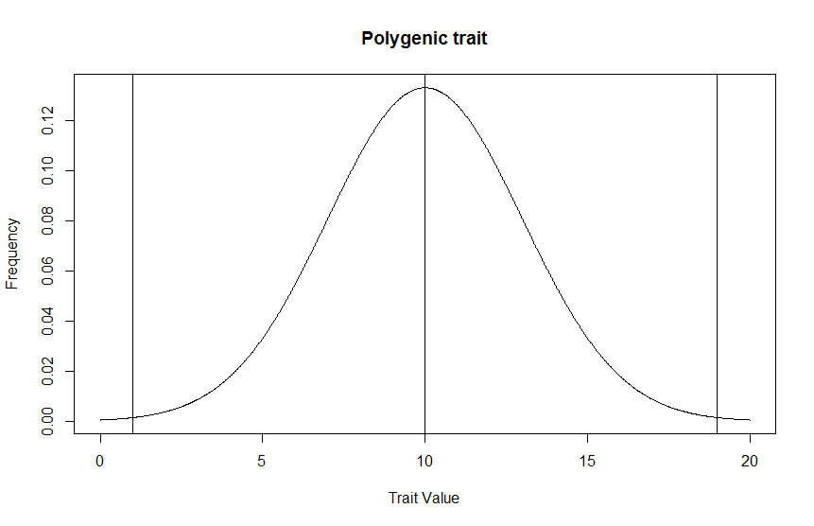
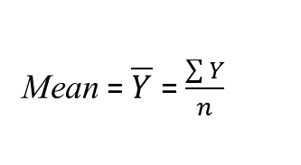
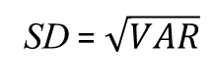
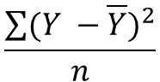
Quantitative trait
(Yield, Height, Digestibility of biomass)
Mean = $\overline{Y}$ = $\frac{\sum{Y}}{n}$
$$\frac{\sum{({Y −\overline{Y})}^{2}}}{n}$$
3 x SD
VAR =
SD = $\sqrt{VAR}$

Slide 6
Backcross
Grandparents: P1 (AB/AB) X P2 (ab/ab)
Parents: F1 (AB/ab) X P2 (ab/ab)
Segregating population: BC1
Genotype Status Probability Observed freq
AB/ab Non-recombinant s/2 n₁
Ab/ab Non-recombinant s/2 n₂
Ab/ab Recombinant r/2 n₃
aB/ab Recombinant r/2 n₄
Total 1 N s = 1-r R = n₃ + n₄ = r*N; rhat = R/N
Van Ooijen, J.W.; Jansen, J (2013) Genetic Mapping in Experimental Populations, Cambridge University Press, Cambridge; pp156

Slide 7
Likelihood ratio and LOD - Backcross
MC = N!/n₁! n₂! n₃! n₄!
LR = l(r = rhat)/l(r = ½);
= 2^{N}(1-R/N)^{N-R}R/N^{R}
LOD = log₁₀(LR)
L(r) = MC(½)^{n1+n2+n3+n4}(1-r)^{n1}(1-r)^{n2}r³r⁴
= MC(½)^{N}(1-r)^{N-R}r^{R}
Log likelihood:
l = (N-R)ln(1-r) + Rln(r)
δl/δr = -(N-R)/(1-r) + R/r
δl/δr = 0;
-(N-R)/(1-r) + R/r = 0;
(N-R)/(1-r) = R/r;
Maximum likelihood estimator
rhat = R/N
Van Ooijen, J.W.; Jansen, J (2013) Genetic Mapping in Experimental Populations, Cambridge University Press, Cambridge; pp156

Slide 8
F2
Grandparents: P1 (AB/AB) X P2 (ab/ab)
Parents: F1 (AB/ab) x
Segregating population: F2
 | Locus B
Locus A | BB | Bb | bb | MP
AA | AB/AB s²/4 | AB/Ab 2rs/4 | Ab/Ab r²/4 | ¼
Aa | AB/aB 2rs/4 | AB/ab Ab/aB 2(r² + s²)/4 | Ab/ab 2rs/4 | ½
aa | aB/aB r²/4 | aB/ab 2rs/4 | ab/ab s²/4 | ¼
MP | ¼ | ½ | ¼
Van Ooijen, J.W.; Jansen, J (2013) Genetic Mapping in Experimental Populations, Cambridge University Press, Cambridge; pp156

Slide 9
F2 - Likelihood
L(r) = (1-r)^{S}r^{R}; S = the number of non-recombinant gametes
S
2 n_{AA,BB} | 1 n_{AA,Bb} | 0 n_{AA,bb}
1 n_{Aa,BB} | 2*p_{co} n_{Aa,Bb} | 1 n_{Aa,bb}
0 n_{aa,BB} | 1 n_{aa,Bb} | 2 n_{aa,bb}
Log likelihood:
l = S ln(1-r) + R ln(r);
Maximum likelihood estimator
rhat = R/(S + R) = R/2N
p_{re} = r²/(r² + s²)
p_{co} = s²/(r² + s²)
R
0 n_{AA,BB} | 1 n_{AA,Bb} | 2 n_{AA,bb}
1 n_{Aa,BB} | 2*p_{re} n_{Aa,Bb} | 1 n_{Aa,bb}
2 n_{aa,BB} | 1 n_{aa,Bb} | 0 n_{aa,bb}
Van Ooijen, J.W.; Jansen, J (2013) Genetic Mapping in Experimental Populations, Cambridge University Press, Cambridge; pp156

Slide 10
Recombination frequency in other mapping populations
 | Locus B
Locus A | BB | Bb | bb
AA | a | b | c
Aa | d | e | f
aa | g | h | i
Double haploid lines : (c + g)/(a + c + g + i)
RILs : (c + g)/2(a + i)

Slide 11
Test for recombination frequency = ½
in backcross
LOD = log10(L₁)/log10(L₀) = log10(L₁) - log10(L₀)
LOD = S*log10(shat) + R*log10(rhat) – S*log10(1/2) – R*log10(1/2)
LOD = S*log10(shat) + R*log10(rhat) + N*log10(2)

Slide 12
Test for recombination frequency = ½
in F2
LOD = log10(L₁)/log10(L₀) = log10(L₁) - log10(L₀)
LOD = n_{AABB}log10(s²/4) + n_{AABb}log10(2rs/4) + … + n_{aabb}log10(s²/4)
- n_{AABB}log10((1/2)²/4) - n_{AABb}log10(2*(1/2)²/4)… - n_{aabb}log10((1/2)²/4)

Slide 13
Determination of linkage groups
Locus B
Locus A | Bb | bb | Total
Aa | n_{Aa,Bb} | n_{Aa,bb} | t_{Aa}
aa | n_{aa,Bb} | n_{aa,bb} | t_{aa}
Total | t_{Bb} | t_{bb} | N
Under the hypothesis that locus A segregates independently from locus B, the probability of each of the four cells is equal to the row and column probabilities.
The row and column probabilities can be estimated by dividing the row and column totals by the overall total.
Estimates for the expected frequencies are obtained by multiplying the cell probabilities with the overall total.
For example: for Aa,Bb the estimate for the expected number of individuals is
Van Ooijen, J.W.; Jansen, J (2013) Genetic Mapping in Experimental Populations, Cambridge University Press, Cambridge; pp156

Slide 14
Locus B
Locus A | Bb | bb | Total
Aa | e_{Aa,Bb} | e_{Aa,bb} | t_{Aa}
aa | e_{aa,Bb} | e_{aa,bb} | t_{aa}
Total | t_{Bb} | t_{bb} | N
e_{Aa,Bb} = (t_{Aa}/N) (t_{Bb}/N) N = t_{Aa}t_{Bb}/N
There are two standard statistics to test the hypothesis of independent segregation
Pearsons χ² statistic
2. Likelihood ratio χ² statistic
χ² = $\sum_{p}{\left(np −ep\right)2 /ep }$
G² = 2$\sum_{p}{np\left(ln⁡(np\right) −ln⁡(ep)) }$
Van Ooijen, J.W.; Jansen, J (2013) Genetic Mapping in Experimental Populations, Cambridge University Press, Cambridge; pp156

Slide 15
Tests for independent segregation
Locus B
Locus A | Bb | bb | Total
Aa | 41 | 8 | 49
aa | 12 | 39 | 51
Total | 53 | 47 | 100
χ² = (41-25.97)²/25.97 + (8-23.03)²/23.03 + (12-27.03)²/27.03 + (39-23.97)²/23.97 = 36.29
Not segregating independently
rhat = 20/100 = 0.2; shat = 0.8
LOD = 80*log10(0.8) + 0.2*log10(0.2) + 100*log10(2) = 8.37
Recombination frequency significantly different from 1/2
Locus B
Locus A | Bb | bb | Total
Aa | 49*53/100 = 25.97 | 49*47/100 = 23.03 | 49
aa | 51*53/100 = 27.03 | 51*47/100 = 23.97 | 51
Total | 53 | 47 | 100
Van Ooijen, J.W.; Jansen, J (2013) Genetic Mapping in Experimental Populations, Cambridge University Press, Cambridge; pp156

Slide 16
Segregation distortion
Locus B
Locus A | Bb | bb | Total
Aa | 1 | 9 | 10
aa | 11 | 79 | 90
Total | 12 | 88 | 100
χ² = (1-1.2)²/1.2 + (9-8.8)²/8.8 + (11-10.8)²/10.8 + (79-79.2)²/79.2 = 0.042
Independent segregation
rhat = 20/100 = 0.2; shat = 0.8
LOD = 80*log10(0.8) + 0.2*log10(0.2) + 100*log10(2) = 8.37
Recombination frequency significantly different from ½
#Preferential germination of certain seed or other selection pressure leading
to segregation distortion.
LOD test unable to distinguish between linkage and segregation distortion.
Independence test loses power under segregation distortion, so does not
lead to false positives
Locus B
Locus A | Bb | bb | Total
Aa | 10*12/100 = 1.2 | 88*10/100 =8.8 | 10
aa | 90*12/100 = 10.8 | 90*88/100 = 79.2 | 90
Total | 12 | 88 | 100
Van Ooijen, J.W.; Jansen, J (2013) Genetic Mapping in Experimental Populations, Cambridge University Press, Cambridge; pp156

Slide 17
Determination of linkage groups
The ln() is the natural logarithm function and the sums are taken over all four phenotype cells.
Both statistics behave like a χ² distribution with 1 degree of freedom.
For large values of n_{p} the two statistics are equivalent.
Deviations from independent segregation will lead to large values of test statistic.
Van Ooijen, J.W.; Jansen, J (2013) Genetic Mapping in Experimental Populations, Cambridge University Press, Cambridge; pp156

Slide 18
Determination of linkage groups
Which significance threshold to use
P ≤ 0.05 will lead to false positives due to chance if many pairs are tested
LOD > 3 often used; linkage is 1000 times more likely
Χ² is then 13.81 which means P = 0.0002
Higher LOD scores often needed to separate linkage groups in dense maps
Van Ooijen, J.W.; Jansen, J (2013) Genetic Mapping in Experimental Populations, Cambridge University Press, Cambridge; pp156

Slide 19
Genetic map estimation
Linkage map creation uses the rate of recombination to determine the distance between loci on the same chromosome (linkage group)
A linkage map gives the order and mutual distances of loci

Slide 20
Three loci in a backcross
Assume crossover events are independent in adjacent sections of the chromosome
r_{AC} = r_{AB}(1- r_{BC}) + (1- r_{AB})r_{BC} = r_{AB} + r_{AB} - 2r_{AB} r_{BC}
Haldane mapping function translates recombination frequencies to additive map distances
d(r_{AC}) = d(r_{AB}) + d(r_{BC})
d = -50ln(1-2r); centiMorgan (cM)
r = (1-exp(-0.02d))/2

Slide 21
Three loci in a backcross
Assume crossover interference
r_{AC} = (r_{AB} + r_{AB})/(1 + 4r_{AB} r_{BC})
d(r_{AC}) = d(r_{AB}) + d(r_{BC})
Kosambi mapping function explains many experimental results better than Haldane
d = 25ln((1+2R)/(1-2r)); centiMorgan (cM)
r = 0.5tanh(0.02d)

Slide 22
Map estimation by linear regression
d_{AB} = δ_{AB} + e_{AB} = 1*δ_{AB} + 0*δ_{BC} + e_{AB}
d_{BC} = δ_{BC} + e_{BC} = 0*δ_{AB} + 1*δ_{BC} + e_{BC}
d_{AC} = δ_{AB} + δ_{BC} + e_{AC} = 1*δ_{AB} + 1*δ_{BC} + e_{AC}

Slide 23
Map estimation by maximum likelihood
Ln(L) = S_{AB}ln(S_{AB}) + R_{AB}ln(R_{AB}) + S_{BC}ln(S_{BC}) + R_{BC}ln(R_{BC}) - N_{t}ln(2)
rhat_{AB} = R_{AB}/N
rhat_{BC} = R_{BC}/N

Slide 24
Outbreeding species
Grandparents: GP1 ai X GP2 bi GP3 ci X GP4 di
Parents: P1 ab P2 cd x
Segregating population: F1 (ac, ad, bc, bd)
Van Ooijen, J.W.; Jansen, J (2013) Genetic Mapping in Experimental Populations, Cambridge University Press, Cambridge; pp156

Slide 25
Cross types in outcrossing species
A: Loci that are heterozygous in both parents and segregate as 1:1:1:1
B: Loci that are heterozygous in both parents and segregate as 1:2:1
C: Loci that are heterozygous in both parents and segregate as 3:1
D: Loci in testcross (backcross) configuration and segregate as 1:1

Slide 26
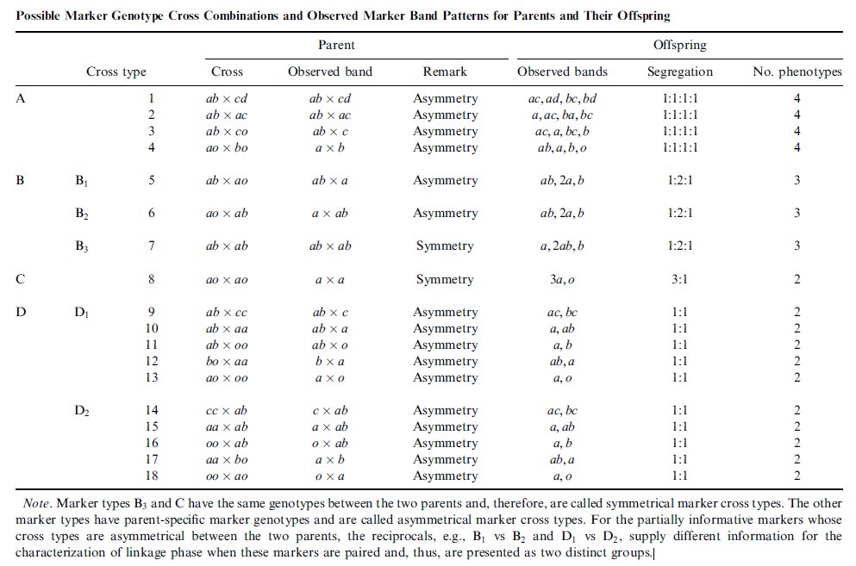
Possible marker genotype cross combinations in outcrossing species
Wu, R. et al. (2002) Simultaneous maximum likelihood estimation of linkage and linkage phases in outcrossing species
Theor. Pop. Biol. 61: 349-363

Slide 27
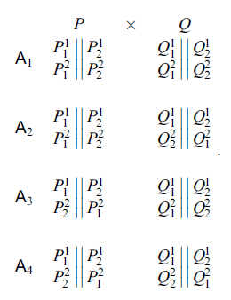
Four possible assignments for the two parents
The label of the first marker is kept unchanged
Calculate the posterior probability given the data to get the
most likely assignment (linkage phase)

Slide 28
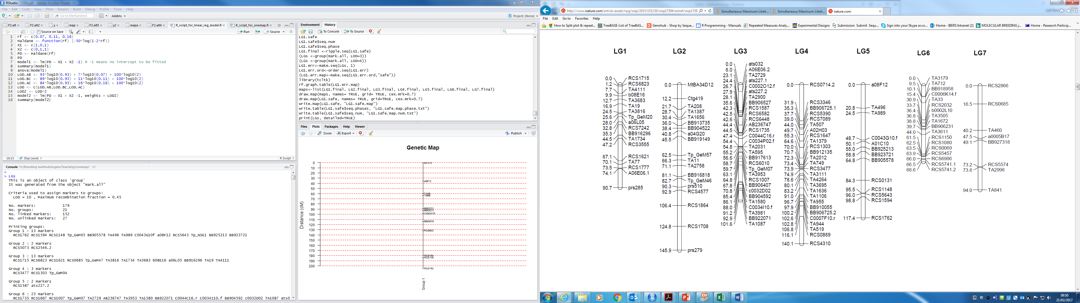
Linkage map of red clover JoinMap

Slide 29
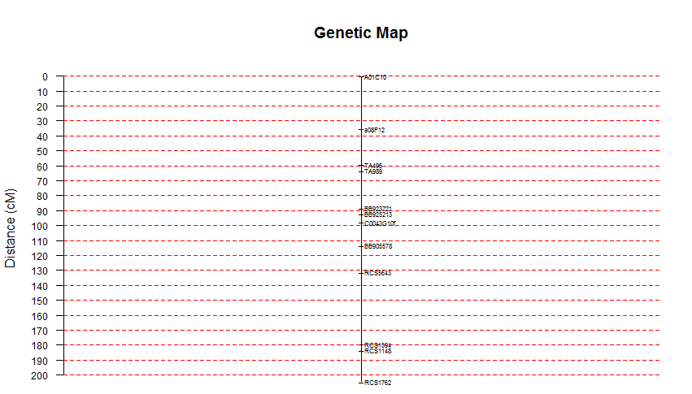
Linkage map of red clover Onemap

Slide 30
a₁
b₁
a₁
a₁
a₂
b₂
c₂
d₂
Genotype | Probability | Observed frequency
a₁a₂ /a₁c₂ | (1-r)/4 | n₁
a₁a₂ /a₁d₂ | (1-r)/4 | n₂
a₁b₂ /a₁c₂ | r/4 | n₃
a₁b₂ /a₁d₂ | r/4 | n₄
b₁a₂ /a₁c₂ | r/4 | n₅
b₁a₂ /a₁d₂ | r/4 | n₆
b₁b₂ /a₁c₂ | (1-r)/4 | n₇
b₁b₂ /a₁d₂ | (1-r)/4 | n₈
Gamete | Frequency
a₁a₂ | (1-r)/2
b₁b₂ | (1-r)/2
a₁b₂ | r/2
a₂b₁ | r/2
Gamete | Frequency
a₁c₂ | ½
a₁d₂ | ½
L = constant + (n₁ + n₂ +n₇ +n₈)log((1-r)/4) + (n₃ + n₄ + n₅ + n₆)log(r/4)
R = (n₃ + n₄ + n₅ + n₆)/N

Slide 31
QTL - Single marker analysis
Conditional Probability | Frequency
P_{QQ}|MM | (1-r)²
P_{Qq}|MM | 2(1-r)r
P_{qq}|MM | r²
P_{QQ}|Mm | (1-r)r
P_{Qq}|Mm | (1-r)²r²
P_{qq}|Mm | (1-r)r
P_{QQ}|mm | r²
P_{Qq}|mm | 2(1-r)r
P_{qq}|mm | (1-r)²
(μ_{MM} – μ_{mm})/2 = a(1-2r)
μ_{Mm} - (μ_{MM} – μ_{mm})/2 = d(1-2r)²
Falconer, D.S. & Mackay, T.F.C (1996) Introduction to Quantitative Genetics, Pearson/Prentice Hall, 464pp

Slide 32
QTL - Single marker analysis
LOD = n/2*log₁₀(RSS₀/RSS₁)
RSS₀ = Residual sum of squares assuming no association with genotypes
RSS₀ = Σ_{i}(y_{i} – ŷ)²
RSS₁ = Residual sum of squares assuming there is a QTL at the marker
RSS₁ = Σ_{i}(y_{i} – μ_{gi})²

Slide 33
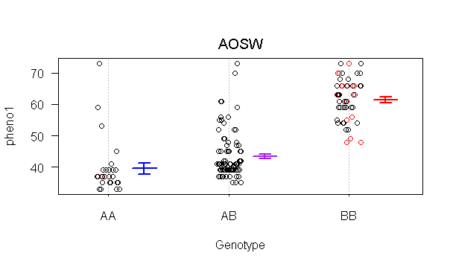
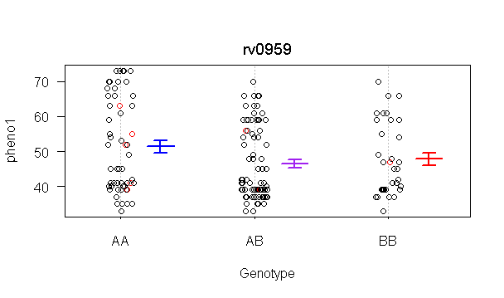
Examples of phenotypes at markers

Slide 34
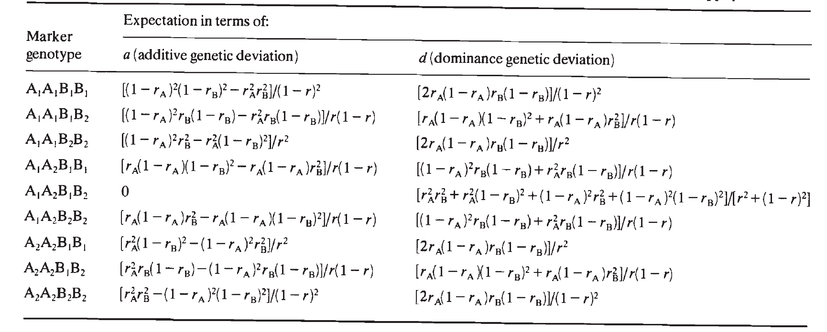
Interval mapping
Estimates the location of a QTL relative to two
flanking markers
Regress the phenotype on the recombination fractions
Haley, C.S. & Knott, S.A. (1992) A simple regression method for mapping quantitative trait loci in line crosses using flanking markers. Heredity, 69: 315-324

Slide 36
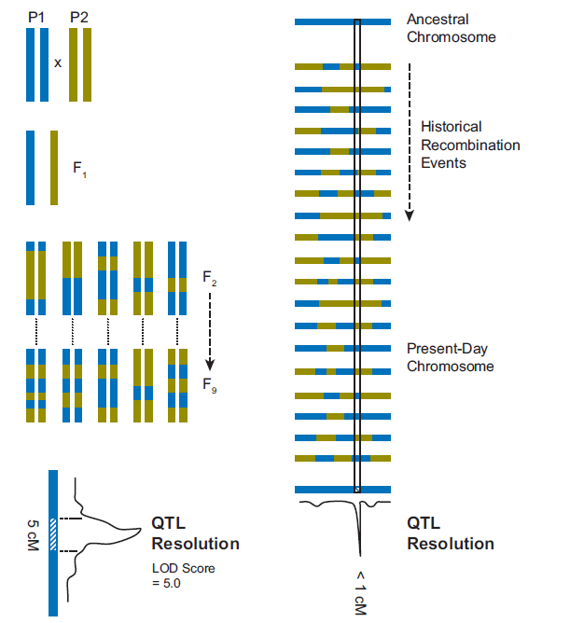
Linkage mapping vs association mapping
Linkage mapping
Association mapping
http://cdn.intechopen.com/pdfs/31471/InTech-Association_mapping_in_plant_genomes.pdf

Slide 37
Linkage analysis has some limitations
Requires growth of 3 generations
prior to assessment
Very large segregating populations
required for high resolution
Molecular markers may be cross-specific

Slide 38
Association or Linkage
Disequilibrium mapping
Aim:
Identify patterns of polymorphisms
that vary systematically between
genotypes with contrasting phenotypes

Slide 39
What is linkage disequilibrium?
Non-random association between alleles at two loci
What does that mean?
Complete disequilibrium
Complete equilibrium
A
A
A
A
A
A
G
G
G
G
G
G
C
C
C
C
C
C
T
T
T
T
T
T
A
A
A
A
A
A
G
G
G
G
G
G
T
T
T
C
C
C
T
T
T
C
C
C

Slide 40
What is linkage disequilibrium?
Complete disequilibrium
Complete equilibrium
A
A
A
A
A
A
G
G
G
G
G
G
C
C
C
C
C
C
T
T
T
T
T
T
A
A
A
A
A
A
G
G
G
G
G
G
T
T
T
C
C
C
T
T
T
C
C
C
Locus A
Locus B
Locus A
Locus B
D = pAB –pA x pB

Slide 41
D = p₁₁p₂₂ - p₁₂p₂₁
Haplotypes or gametes
Frequency
A₁
B₁
p₁₁
A₁
B₂
p₁₂
A₂
B₁
p₂₁
A₂
B₂
p₂₂
r

Slide 42
D = p₁₁p₂₂ - p₁₂p₂₁
pA₁ = p_{1.} = p₁₁ + p₁₂
Haplotypes or gametes
Frequency
pA₂ = p_{2.} = p₂₁ + p₂₂
A₁
B₁
p₁₁
pB₁ = p_{.1} = p₁₁ + p₂₁
A₁
B₂
p₁₂
pB₂ = p_{.2} = p₁₂ + p₂₂
A₂
B₁
p₂₁
A₂
B₂
p₂₂
r

Slide 43
pA₁ = p_{1.} = p₁₁ + p₁₂
D = p₁₁p₂₂ - p₁₂p₂₁
pA₂ = p_{2.} = p₂₁ + p₂₂
pB₁ = p_{.1} = p₁₁ + p₂₁
Haplotypes or gametes
Frequency
pB₂ = p_{.2} = p₁₂ + p₂₂
A₁
B₁
p₁₁
p₁₁ = pA₁B₁ = (p₁₁ + p₁₂)(p₁₁ + p₂₁) = p_{1.} p_{.1} + D
A₁
B₂
p₁₂
p₁₂ = pA₁B₂ = (p₁₁ + p₁₂)(p₁₂ + p₂₂) = p_{1.} p_{.2} - D
A₂
B₁
p₂₁
p₂₁ = pA₂B₁ = (p₂₁ + p₂₂)(p₁₁ + p₂₁) = p_{2.} p_{.1} - D
A₂
B₂
p₂₂
p₂₂ = pA₂B₂ = (p₂₁ + p₂₂)(p₁₂ + p₂₂) = p_{2.} p_{.2} + D
r

Slide 44
Gametes, alleles and frequencies
in a two-locus, two-allele model
Genotype | Frq | Allele | Frq
A₁B₁ | p₁₁ | A₁ | p₁₁+p₁₂
A₁B₂ | p₁₂ | A₂ | p₂₁+p₂₂
A₂B₁ | p₂₁ | B₁ | p₁₁+p₂₁
A₂B₂ | p₂₂ | B₂ | p₁₂+p₂₂
Hedrick, PW (2000) Genetics of populations. Jones and Bartlett Pubs MA, USA

Slide 45
Measures of LD
D is dependent upon allele frequencies
We wish to normalize the expression (0 – 1)
D’ = D/D_{max}
D_{max} = lesser of pA₂pB₁ or pA₁pB₂ if D is positive
D_{max} = lesser of pA₁pB₁ or pA₂pB₂ if D is negative
r² = D²/(pA₁pB₁pA₂pB₂)

Slide 46
Linkage disequilibrium
Complete disequilibrium
Complete equilibrium
A
A
A
A
A
A
G
G
G
G
G
G
C
C
C
C
C
C
T
T
T
T
T
T
A
A
A
A
A
A
G
G
G
G
G
G
T
T
T
C
C
C
T
T
T
C
C
C
Locus A
Locus B
Locus A
Locus B

Slide 47
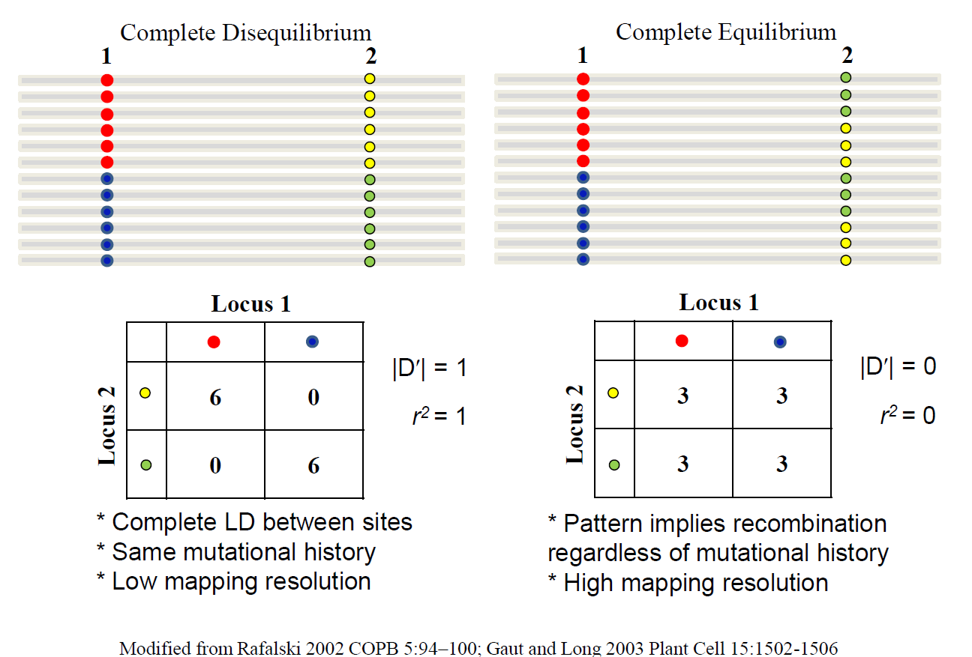
Linkage disequilibrium

Slide 48
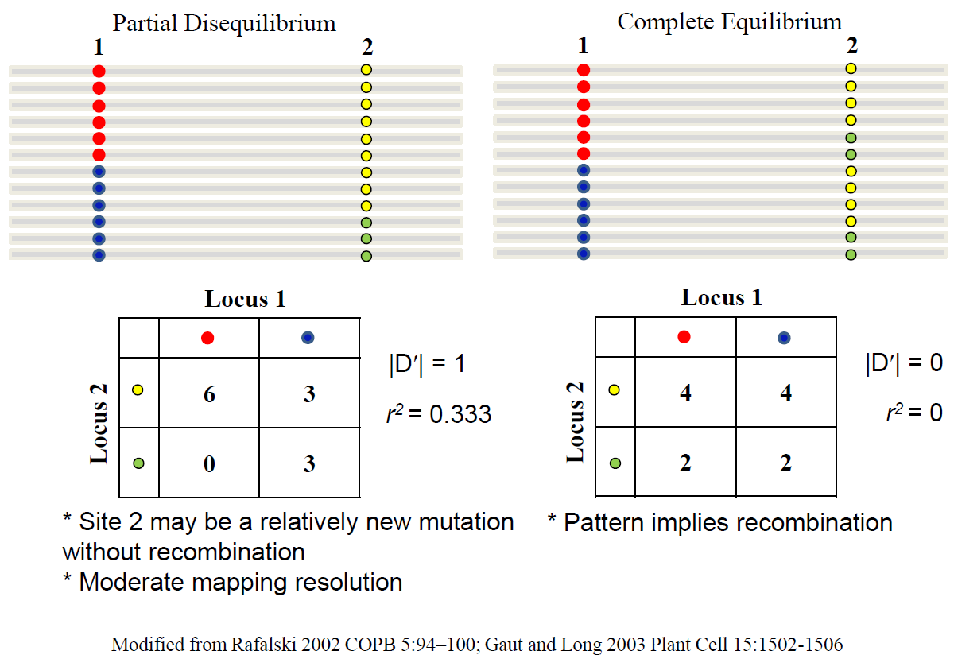
Linkage disequilibrium

Slide 49
Linkage disequilibrium or association
mapping is a complementary approach to
linkage mapping
Attempts to do the same as linkage mapping but without
the pedigree information. It uses a population of unrelated
individuals
Assumes that associations between a marker allele
and phenotypes are due to linkage rather than chance

Slide 50

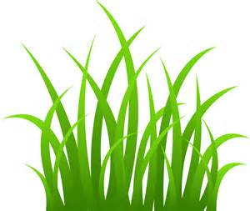
Association mapping
Single-Nucleotide Polymorphism (SNP)
Plant 1…TGAACCTAAGTATGTCCG…
Plant 2…TGAACCTAAGTATGTCCG…
Plant 3…TGAACCTAAGTATGTCCG…
Plant 4…TGAACCTAGGTATGTCCG…
Plant 5…TGAACCTAGGTATGTCCG…
Plant 6…TGAACCTAGGTATGTCCG…

Slide 51
Association mapping
Single-Nucleotide Polymorphism (SNP)
Plant 1…TGAACCTAAGTATGTCCG…
Plant 2…TGAACCTAAGTATGTCCG…
Plant 3…TGAACCTAAGTATGTCCG…
Plant 4…TGAACCTAGGTATGTCCG…
Plant 5…TGAACCTAGGTATGTCCG…
Plant 6…TGAACCTAGGTATGTCCG…

Slide 52
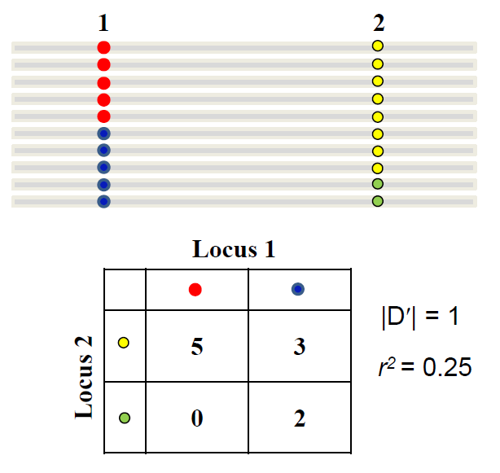
r² is used in association mapping
Example: Marker 1 is a QTL explaining 10% of total
Phenotypic variance, so it is not the causative SNP
SNP marker 2 explains 25% (r² = 0.25), but it only
Explains 2.5% of total phenotypic variance.
This requires large sample sizes for sufficient power,
Or higher value of r²

Slide 53
Effect of recombination rate on decay of
Linkage disequilibrium
D_{t} = (1 – r)^{t}D₀
r=0.001
r=0.01
r=0.05
r=0.1
r=0.5

Slide 54
Linkage disequilibrium decay with distance
in perennial ryegrass
Real populations are not
necessarily in H – W equilibrium:
p² + 2pq + q² = 1
Allele and genotype frequencies
do change over generations

Slide 55
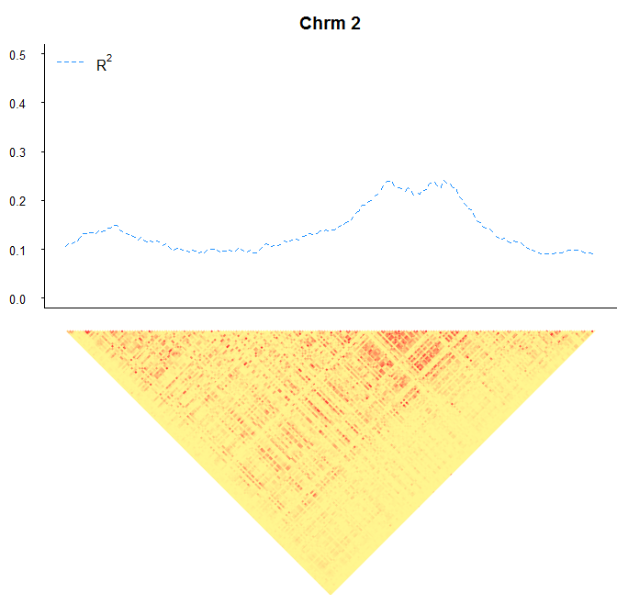
Linkage disequilibrium landscape
in perennial ryegrass

Slide 56
Inbreeding or reproductive system
Selfing delays the decay of LD
Outcrossing decreases LD
Species | LD | Criterion
Human (Europe) | 60 kb | D’ half
Human (Africa) | 5 kb | D’ half
Cattle | >10cM | D’ half
A. thaliana | 50-100 kb | r² half
Soybean | >50 kb | Little decay
Norway spruce | 100 bp | r² half
Grape | >500 bp | r² half
Maize | ~400 bp | r²=0.2
Maize inbreds | 1 kb | r²=0.2
Rafalski & Morgante (2004) TIGS 20, 103-111

Slide 57
Say we want r² = 0.5 or more to allow us reasonable power
Ryegrass genome size is 2500 Mb
LD decays to 0.5 in 10 Kb
We would ideally need a marker for every 20 Kb, so
125,000 evenly spaced markers needed.

Slide 58
Population structure
Cases disproportionately represent a genetic subgroup
Cases Controls
Population 1
Population 2

Slide 59
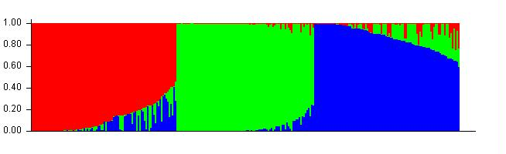
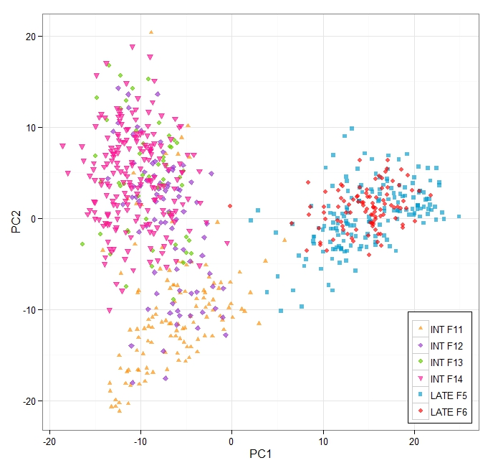
Population structure of three ryegrass varieties
Calculated based on allele frequencies
Population structure visualised
from principle component analysis
Also based on allele frequencies
a)
AberDart AberMagic AberStar

Slide 60
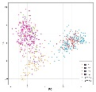
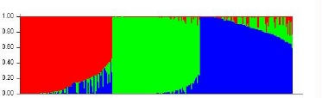
Evaluate Genotype-Phenotype
associations
Assess population structure
PCA analysis)
“Structured association”
Filter polymorphisms
Eliminate rare polymorphisms (<5%)
Test associations
Χ² analysis or exact test if trait is binary
t-test, Analysis of variance or regression if trait is
quantitative
Statistical evaluation
Permutations, corrections for multiple test
(Bonferroni, false discovery rate (FDR))

